Slide 1
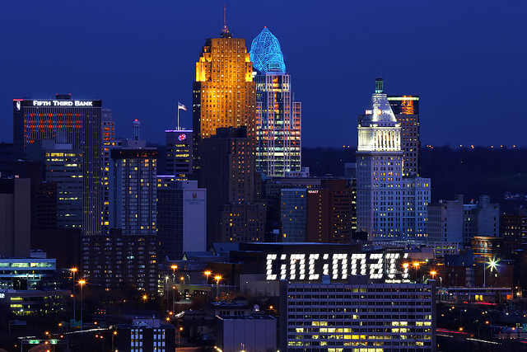
The Westside: A Place Unlike Any Other
Meghan Cappel, Taylor Ehrman, Neil Mullen

Slide 2
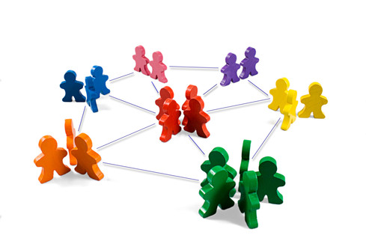
The Networking Factor
Leaping off point
A giant family
Established businesspeople
Use network to succeed

Slide 3
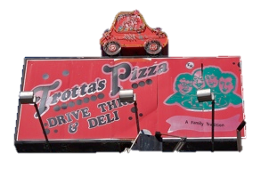
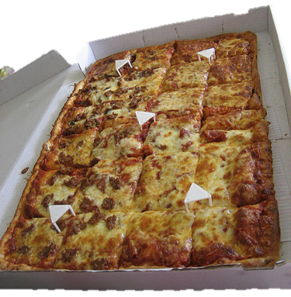
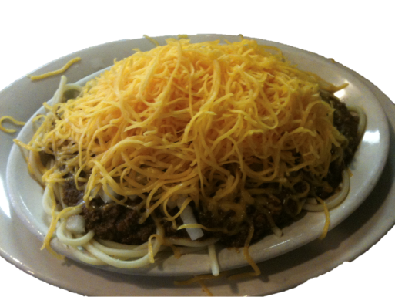

Slide 4
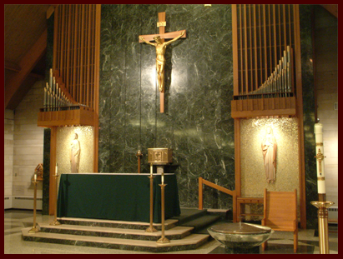
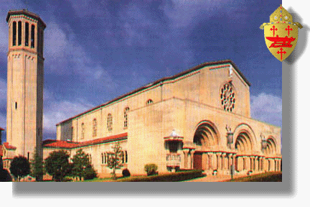
“Where did you go to school?”
Not a simple question
Many Catholic elementary schools and high schools to compliment public schools

Slide 5
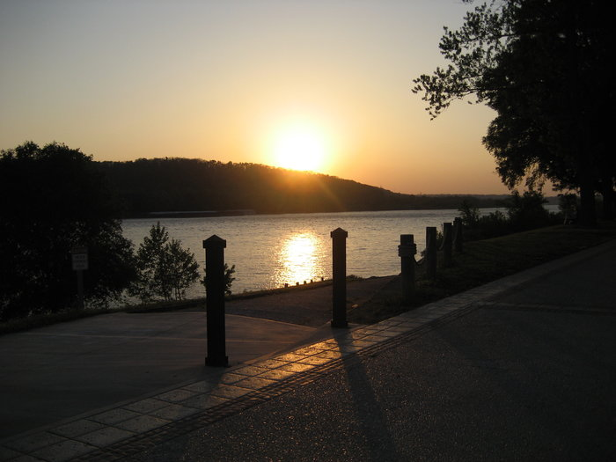
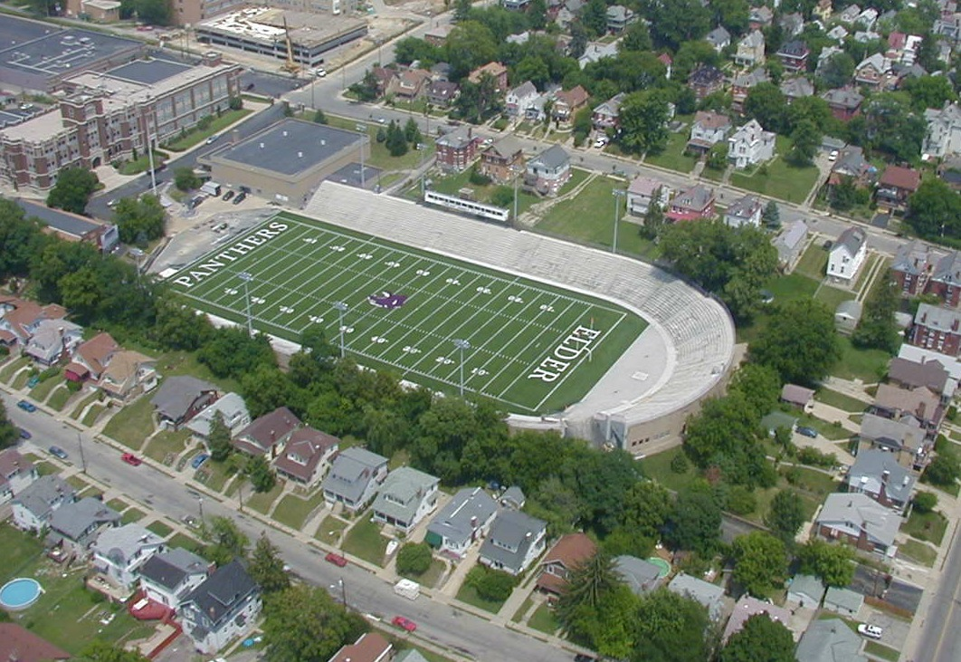
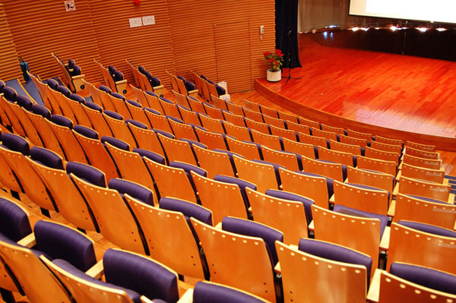
Community Landscape

Slide 6
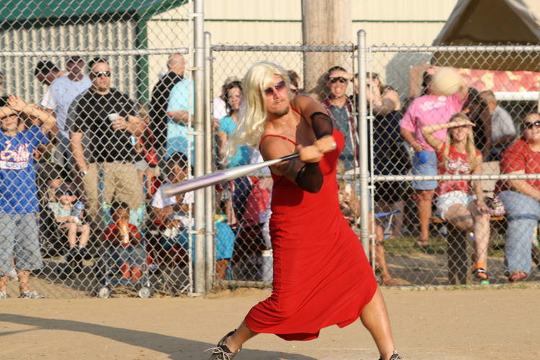
Community Involvement

Slide 7
Our Home
Big section of the city, yet has a village feel
Old and historic, but new and bright
Wide variation of people
Many occupations and income levels, but conservative values remain constant
Proud area for small businesses

